Slide 1

Federal University of Rio de Janeiro

Slide 2
Mission, vision, and values

Slide 3
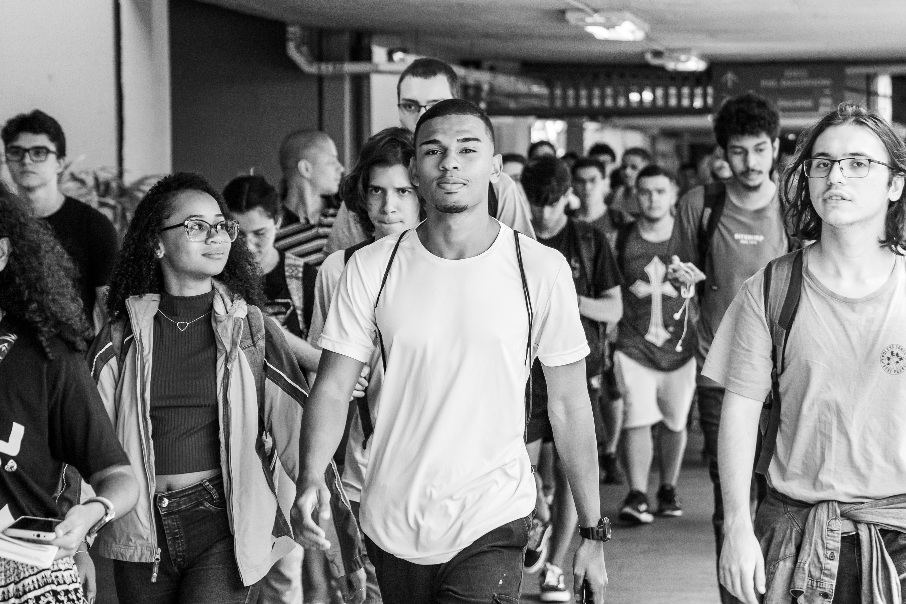
“…promoting the formation of a just, democratic, and egalitarian society.”
Photo: Students of CCMN – by Moisés Pimentel

Slide 4
UFRJ
Mission, vision, and values
Mission
To contribute to the scientific, technological, artistic, and cultural advancement of society through teaching, research, and outreach, fostering the construction of a just, democratic, and egalitarian society.
Vision
To position itself among the world’s leading institutions in civic education across diverse fields of knowledge, integrating them to address the many challenges of our century and standing out as a transformative force in socioeconomic and environmental reality.

Slide 5
UFRJ
Mission, vision, and values
Values
Academic excellence;
Freedom of thought and expression;
Social and environmental responsibility;
Ethics and transparency;
Diversity, accessibility, and inclusion;
University autonomy in teaching, research, administration, and management.

Slide 6
Created to be a reference

Slide 7
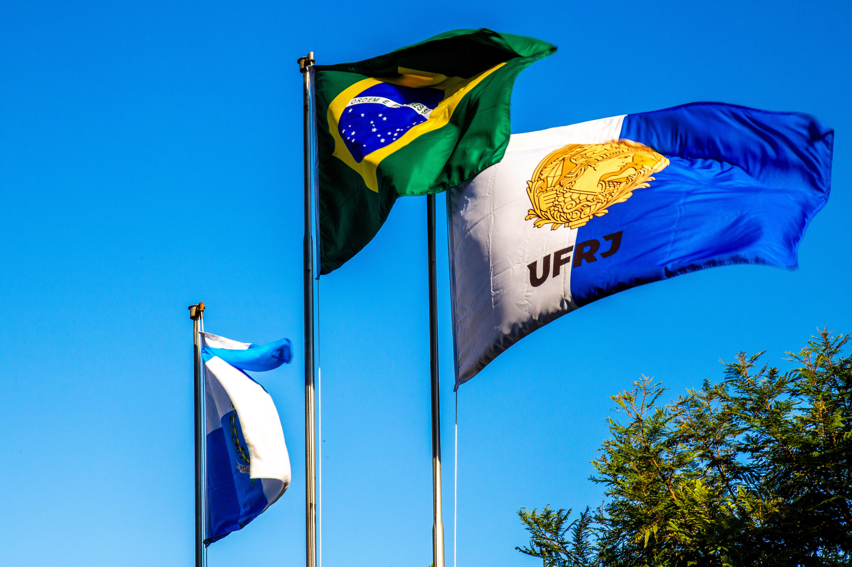
“To walk through UFRJ’s history (…) is also to journey through the very History of Brazil.” (OLIVEIRA, Antônio)
Photo: Flags of Brazil and UFRJ – By Moisés Pimentel

Slide 8


UFRJ
Created to be a reference
The first official institution of higher education in Brazil, active since 1792 through the Polytechnic School, and organized as a university in 1920. UFRJ was founded with the mission to serve as a model for existing and future universities in the country.
According to international rankings, UFRJ has advanced more than 65 positions in recent years and is currently:
2nd best university in Brazil (CWUR Rankings)
5th best university in Latin America and the Caribbean (QS Rankings)

Slide 9


UFRJ
Created to be a reference
In 2024, UFRJ partnered with the Ministry of Education in supporting the organization of the G20 Brazil preparatory meetings.
Also in 2024, it hosted the XXXIII Meeting of the Association of Portuguese-Speaking Universities (AULP).

Slide 10

UFRJ
Created to be a reference
In 2025, UFRJ hosted the 2nd Forum of Rectors of BRICS+ Universities, in partnership with ANDIFES, FRIPERJ, and with support from the Federal Government and the City of Rio de Janeiro.

Slide 11
Structure

Slide 12
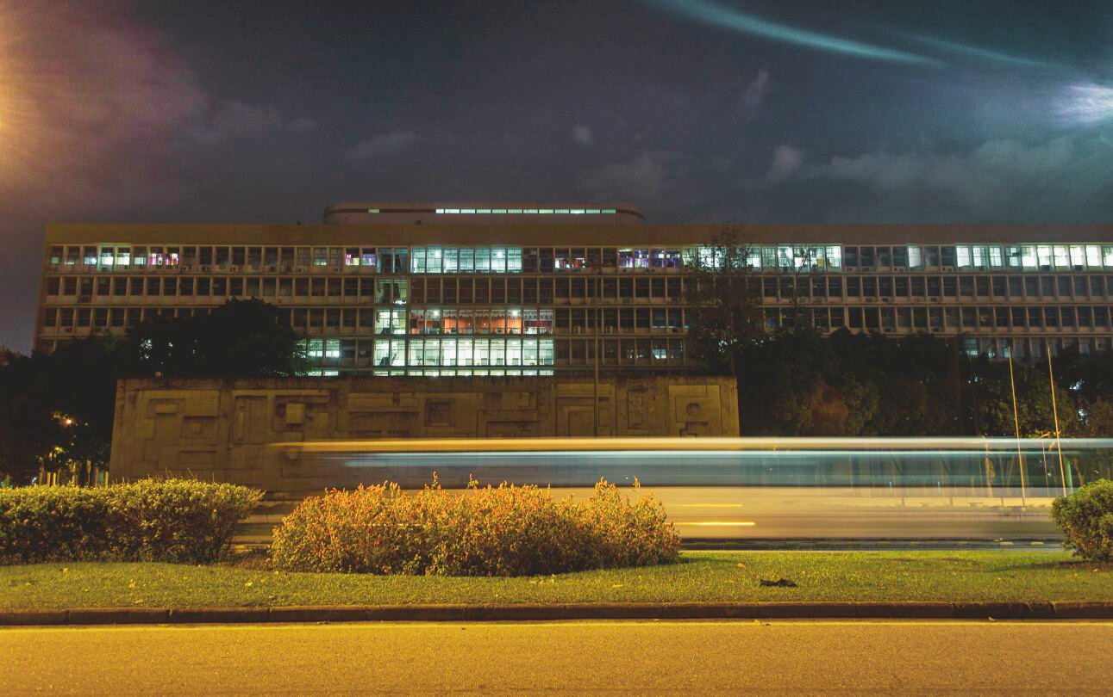
With around 80,000 people, UFRJ has the structure of a medium-sized city, reflecting its strategic importance for Brazil.
Photo: University bus in front of Jorge Machado Moreira Building at dusk – by Raphael Pizzino

Slide 13
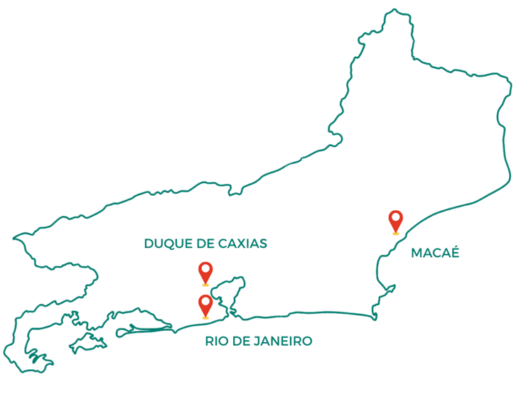
UFRJ
Campuses and facilities
The University’s structure is distributed across three municipalities, in the following locations:
Fundão Campus – University City (Rio de Janeiro);
Praia Vermelha Campus (Rio de Janeiro);
Macaé Campus;
Duque de Caxias Campus;
12 additional facilities not linked to a specific campus.

Slide 14
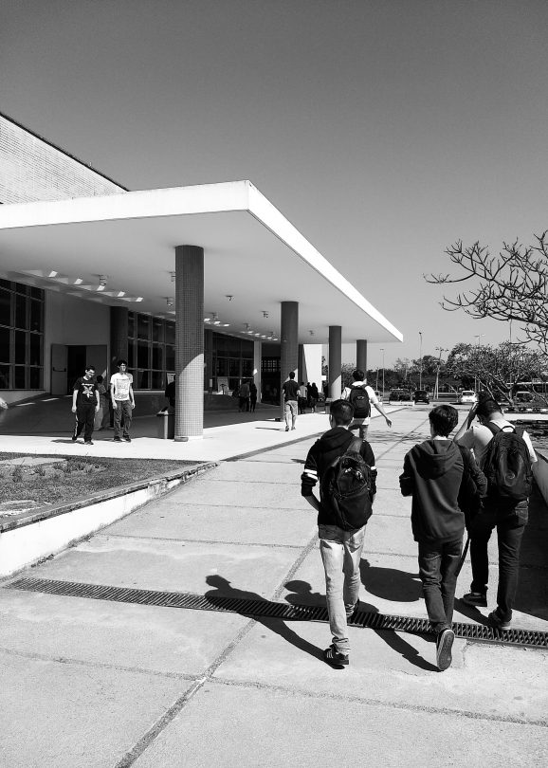
UFRJ
Structure
Organization of academic units
Center for Legal and Economic Sciences (CCJE);
Center for Mathematical and Natural Sciences (CCMN);
Center for Health Sciences (CCS);
Center for Philosophy and Human Sciences (CFCH);
Center for Arts and Letters (CLA);
Center for Technology (CT);
Duque de Caxias Campus;
Macaé Multidisciplinary Center;
Teacher Training Complex;
University Hospital Complex;
Forum of Science and Culture (FCC).
Students at the entrance of the Central University Restaurant – By Jorge Rappel

Slide 15
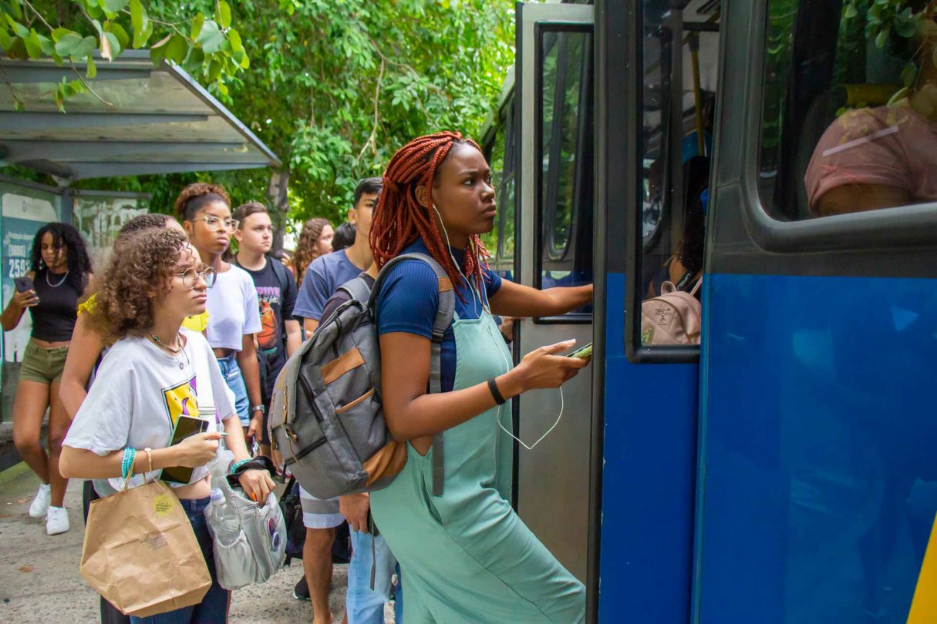
UFRJ
Structure
Highlights
9 university hospitals integrated with Brazil’s public health system (SUS);
Free exclusive bus lines within and between campuses;
1,456 laboratories;
44 libraries;
19 museums and cultural entities;
8 university restaurants.
Students boarding a UFRJ bus at the Cidade Universitária campus – By Fábio Caffé

Slide 16
Teaching, Research, and Outreach

Slide 17
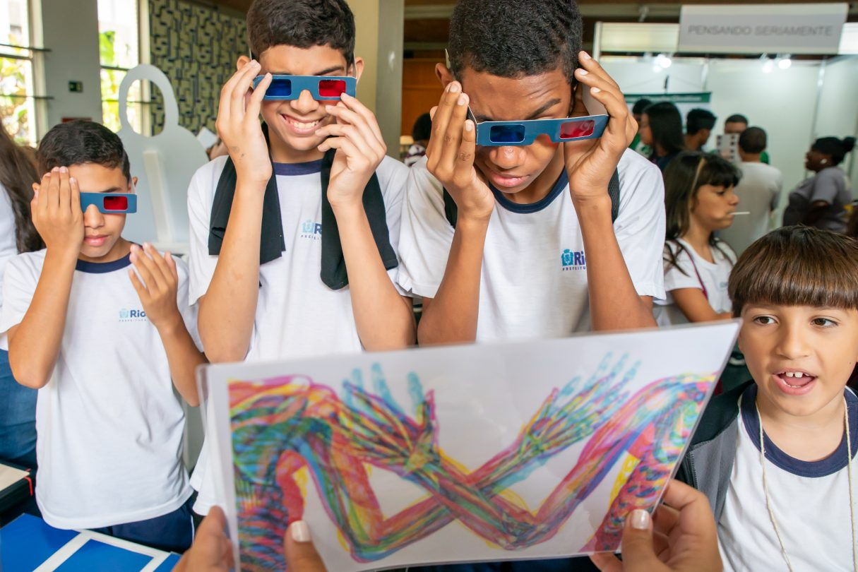
UFRJ’s pillars - teaching, research, and outreach - stand out for their thematic diversity, fostering continuous and enriching dialogue among different fields of knowledge.
National Science and Technology Week 2024 at UFRJ. Ilha do Fundão, RJ, 10/18/2024 – By Fábio Caffé

Slide 18
UFRJ
Teaching, Research, and Outreach
Undergraduate education
Graduate education
~53,500 students;
9,000 new admissions per year;
172 on-campus programs;
4 distance-learning programs;
24 evening programs;
social benefits for low-income students;
affirmative action policies based on racial, educational, and social criteria.
~15,700 students;
among the 3 most cited universities in Brazil;
200 specialization programs;
136 master’s and doctoral programs;
1,456 laboratories;
hosts 10% of Brazil’s internationally accredited graduate programs;
admission policies include racial and social quotas.

Slide 19

UFRJ
CAPES-‘Excellent’ Graduate Programs
Administration
Social Anthropology
Biodiversity and Evolutionary Biology
Biochemistry
Morphological Sciences
Microbiology
Biophysics
Physiology
Genetics
Clinical Medicine
Communication
Ecology
Science and Health Education
Civil Engineering
Systems and Computer Engineering
Mechanical Engineering
Chemical Engineering
Physics
Geography
Social History
Languages and Literature (Vernacular Languages)
Mathematics
Biological Chemistry
Sociology and Anthropology
Urban Planning

Slide 20
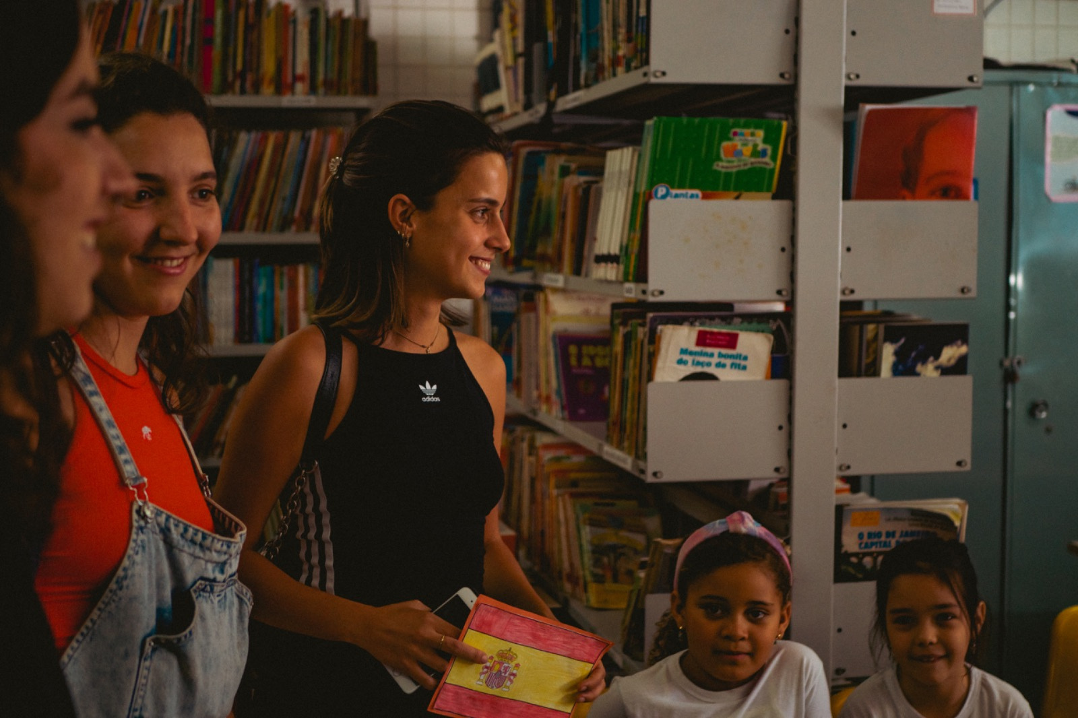
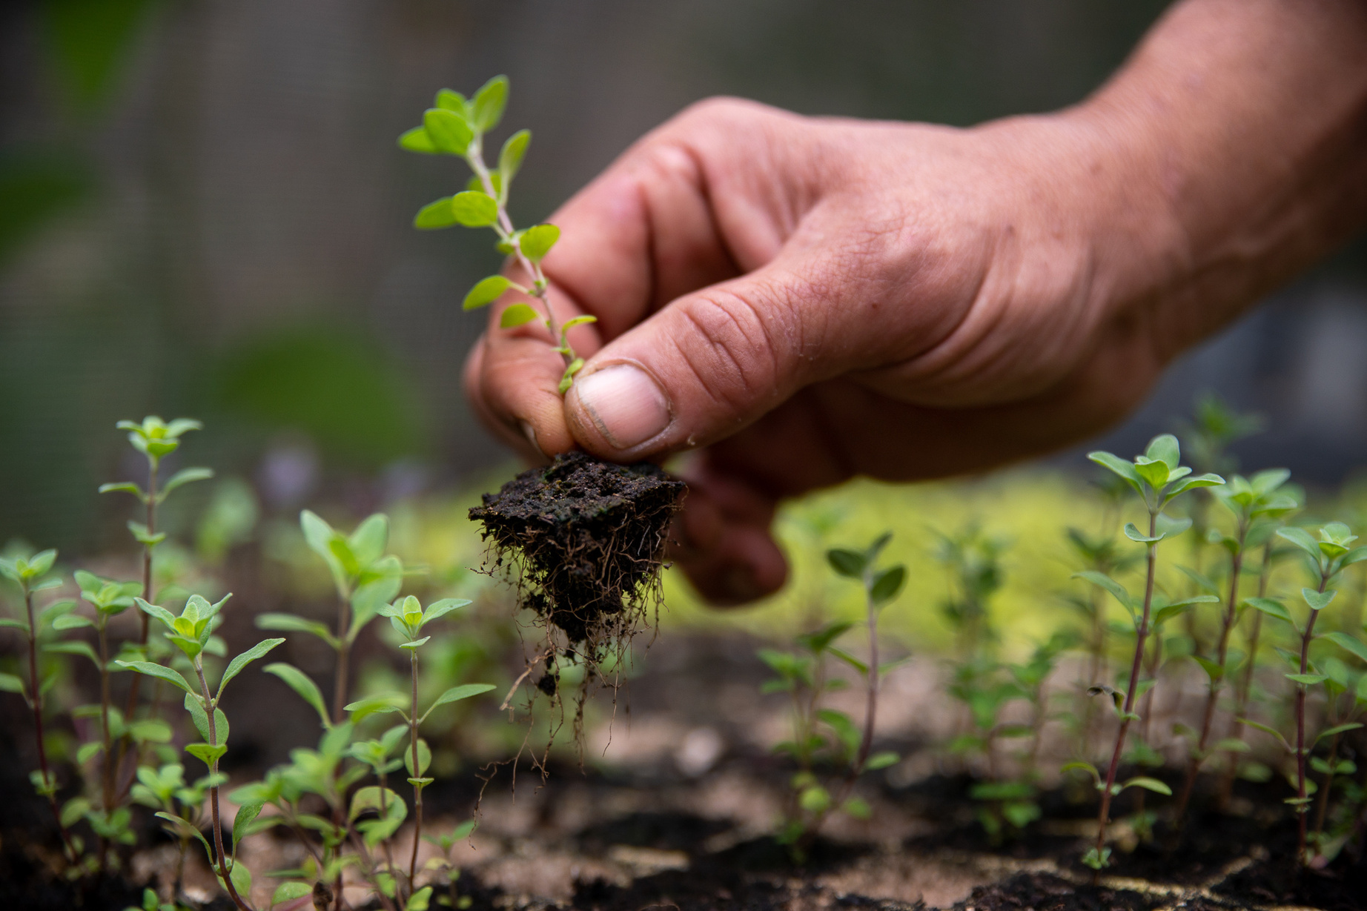
UFRJ
University outreach
Highlights
1,863 projects and courses for the broader community;
Academic Integration Week (SIAC);
“Discovering UFRJ” programs for schools and communities.
International students during a visit activity at a municipal school in Rio de Janeiro – SGRI collection

Slide 21
International

Slide 22
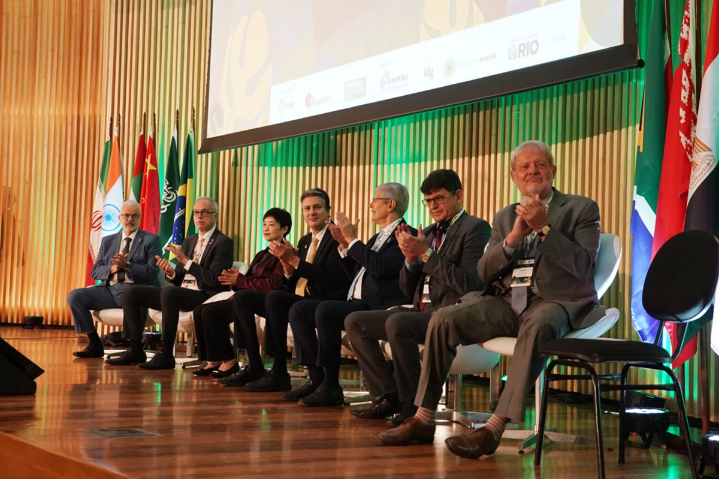
BRICS+ 2025 Rectors’ Forum at the Museum of Tomorrow – by Fábio Caffé (SGCOM/UFRJ).”

Slide 23
UFRJ
International
Foreign students have free access to almost all programs at UFRJ—undergraduate, graduate, and short-term courses.
Admission for students with foreign diplomas follows the same procedures as for Brazilian students, provided they meet all requirements stated in the calls for applications.
Exchange programs, however, require a specific agreement between institutions and reciprocal tuition waivers.
Beyond exchange, UFRJ maintains partnerships for dual degrees, joint PhDs (cotutelle), and international networks.

Slide 24










UFRJ
International associations
UFRJ participates as a full member in various national and international associations.

Slide 25
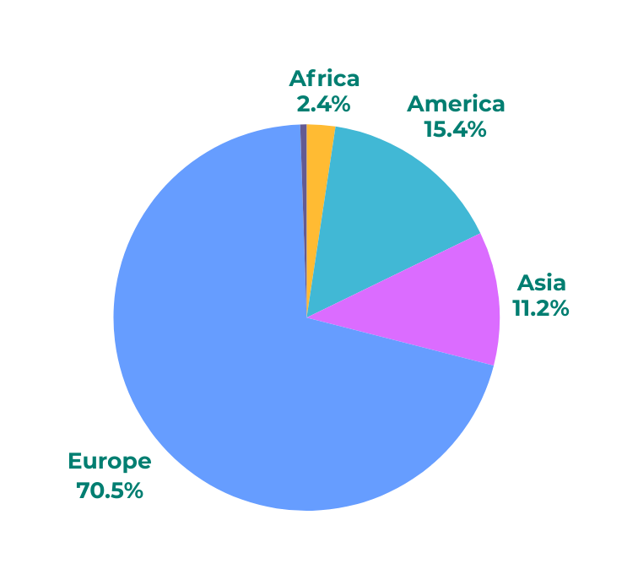
UFRJ
International agreements
Distribution of agreements by region
Highlights
14 undergraduate dual-degree agreements;
160 exchange agreements;
182 memoranda of understanding (MoU);
44 joint PhD (cotutelle) agreements (2022–2025);
20 research cooperation agreements.

Slide 26
UFRJ
Types of agreements
Specific Agreement
Memorandum of Understanding (MoU)
Establishes a formal commitment linking the institutions;
Expresses mutual interest, without binding obligations.
There is no obligation to transfer financial resources among the parties;
It merely formalizes the interest in mutual cooperation, to be implemented through future Specific Agreements.
Formalizes technical, scientific, cultural, and academic cooperation (e.g., exchange, research cooperation, Erasmus mobility).
Responsible department: Division of International Academic Agreements of SGRI, except for joint supervision in graduate programs.

Slide 27
UFRJ
Types of agreements
Cotutelle (Joint Supervision of Master’s and PhD)
Undergraduate Double Degree Agreement
Allow the student, after a certain period, to receive degrees from both UFRJ and the partner institution.
Open agreements: allow multiple students during validity.
Closed agreements: valid only for named candidates.
Responsible department: Division of International Agreements of SGRI
Responsible department: Division of Teaching of PR2

Slide 28

UFRJ
Academic Exchange
Available at undergraduate and graduate levels;
Programs include Erasmus+, AUGM, REARI-RJ, and Magalhães networks;
~250 Brazilian students abroad annually;
~220 international students hosted at UFRJ per year.
Plane flying over Cidade Universitária – By Raphael Pizzino

Slide 29
UFRJ
Academic exchange at UFRJ
Requirements
Nomination and formal application through a UFRJ partner university;
For Brazilian nationals/dual citizens: ID, CPF, voter registration, and (for men) military service certificate;
Approved academic record by UFRJ faculty coordinator;
Travel insurance covering repatriation.
Student visa (VITEM IV) valid for the entire study period (except short-term programs);

Slide 30
UFRJ
Academic exchange at UFRJ
UFRJ undergraduate and graduate exchange programs are exclusive to students from partner institutions.
Where to apply
Applications must be submitted by partner institutions directly to UFRJ’s International Office (SGRI).
Applications sent individually by students are not accepted.
Application Deadlines*:
March 1–31 - for fall semester (Aug–Dec) or full academic year starting in August;
October 1–31 → for spring semester (Mar–Jul) or full academic year starting in March.
*Application periods are set for submissions to SGRI, provided there are no changes in the academic calendar.

Slide 31

“"...to form a just, democratic, plural, and egalitarian society."
UFRJ flag – By Raphael Pizzino

Slide 32


Produced by SGRI (International Relations Office) Team.
Quotes extracted from the Institutional Development Plan (PDI) and images from UFRJ’s official repository (panorama.ufrj.br) and the SGRI archives.
For suggestions: midia@internacional.ufrj.br.
Visit internacional.ufrj.br and follow us on social media:
@ufrjinternacional
facebook.com/ufrjinternational

