Slide 1
Universidade Federal do Rio de Janeiro
International Relations Office
SGRI

Slide 2
“... a visit through the history of Brazil.” (Antonio Oliveira - FACC/UFRJ)

Slide 3

UFRJ National Museum – Former House of the Emperor of Brazil – by Raphael Pizzino.

Slide 4
Created to be a benchmark

Slide 5
UFRJ | Created to be a benchmark
UFRJ is the first official institution of higher education in the country, operating as the Polytechnic School since 1792. In 1920, this instituition was incorporated as a university with the mission of being a benchmark for existing higher education institutions and even for those to be created in the future.
Its mission is to contribute to the scientific, technological, artistic and cultural advancement of society through its teaching, research and outreach activities and to promote a fair, democratic and egalitarian society.

Slide 6
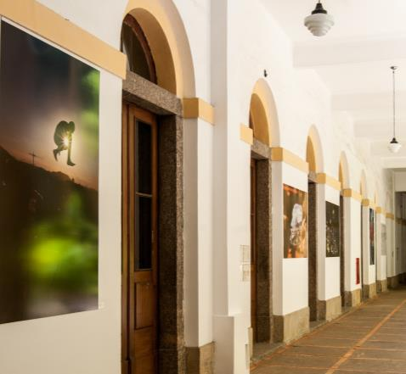
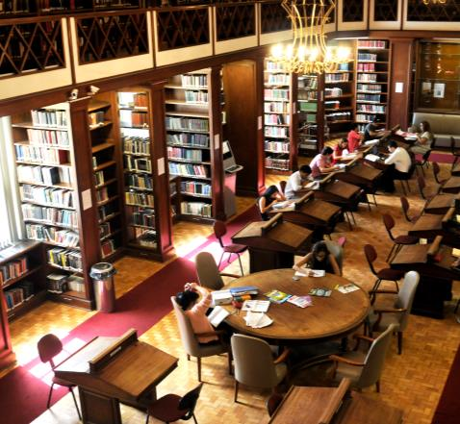
On the left – Corridor of the old Polytechnic School Building - by Diogo Vasconcelos.
On the right – Library of the National Law School - by Nathalia Werneck.

Slide 7


UFRJ | Created to be a benchmark
According to international assessment institutions, today UFRJ ranks third overall in Brazil and first among federal universities. Some of its faculties are among the best in the world.
3rd overall in Brazil
Best federal university in Brazil

Slide 8
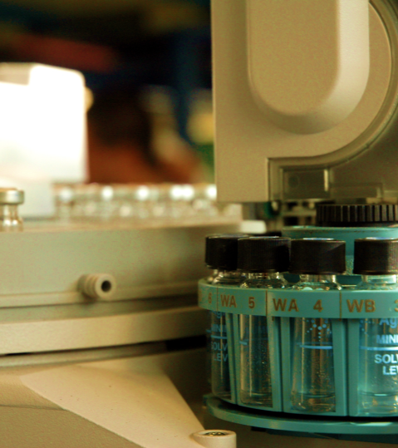
Benchmark
Since the beginning of the COVID-19 pandemic, UFRJ has been a national benchmark in tackling the crisis.
+ 3000 mentions in media vehicles, providing scientific and safe information to society.
Reproduction of S-protein - allowed for the development of an effective and low-cost serological test
“VaxCo” ventilator - 90% cheaper than conventional equipment.
Foto – Laboratório LADETEC – Acervo COORDCOM
Notes:
Texto do LADEC em formato de imagem

Slide 9
Structure

Slide 10
UFRJ | Structure
UFRJ’s structure is similar to that of a medium-sized city, compatible with its strategic relevance for the development of the country. If we only take into account teachers, students and administrative staff, there are about 80 thousand people.
Around 100,000 people use to attend the Cidade Universitária campus daily before the Covid-19 pandemic.

Slide 11
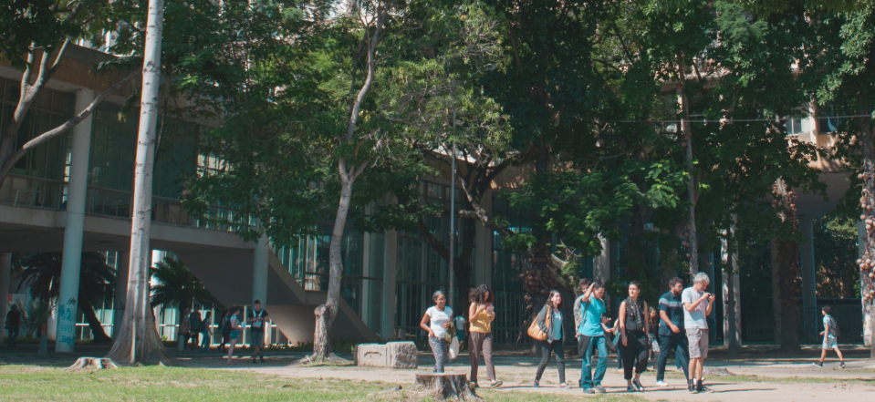
Students in front of the building of the Faculty of Architecture and Urbanism – by Diogo Vasconcelos.

Slide 12
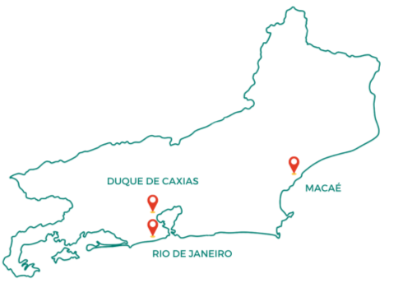
4 campuses and more +
Fundão – Cidade Universitária campus;
Praia Vermelha campus;
Macaé campus;
Duque de Caxias campus;
12 locations not linked to the campuses;
9 hospitals;
1.456 registered labs;
44 libraries;
19 museum entities.
Map of the State of Rio de Janeiro.

Slide 13
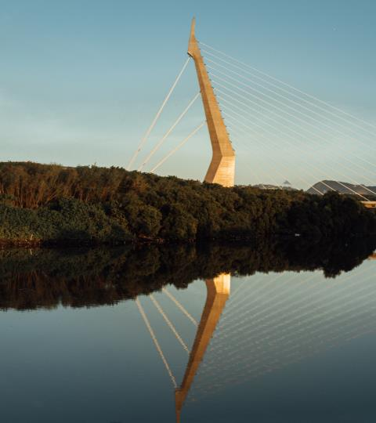
Fundão campus
4.266.095 m²;
Biodiversity;
100k people/day;
Most of the university’s degrees;
Technological park;
It hosts large companies and research centers.
Ponte do Saber (bridge) – One of the main exits from Ilha do Fundão – By Raphael Pizzino.

Slide 14
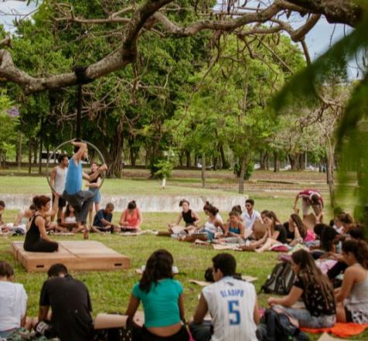
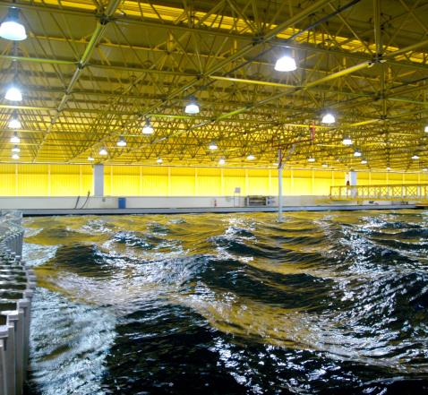
On the left: Fine Arts students in class - By Ana Maria Coutinho.
On the right: Ocean Laboratory tank. The deepest test tank in the world. COODCOM collection.

Slide 15
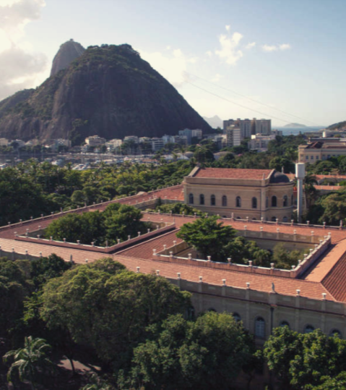
Praia Vermelha campus
UFRJ’s first main office;
In the tourist region of Rio;
Center for Legal and Economic Sciences;
Center for Philosophy and Human Sciences;
Institute of Psychiatry;
Deolindo Couto Neurology Hospital;
Science and Culture Forum.
University Palace seen from above, with Sugarloaf Mountain in the background - Photo by Vstrabelli – Own work, CC BY-SA 4.0,

Slide 16
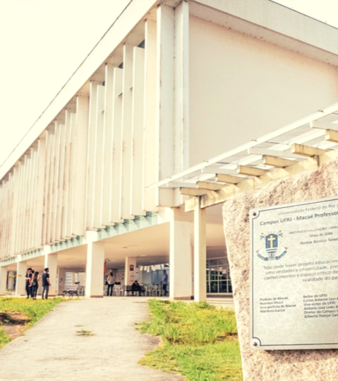
New campuses
Duque de Caxias campus
  UFRJ’s newest campus;
  It hosts undergraduate and graduate courses.
Macaé center
  189km from Rio de Janeiro; it serves the population of the North of Rio;
  11 undergraduate degrees and 3 master’s degrees.
Campus de Macaé – Por Raphael Pizzino.
Notes:
Texo do campus de Macaé em formato de imagem

Slide 17
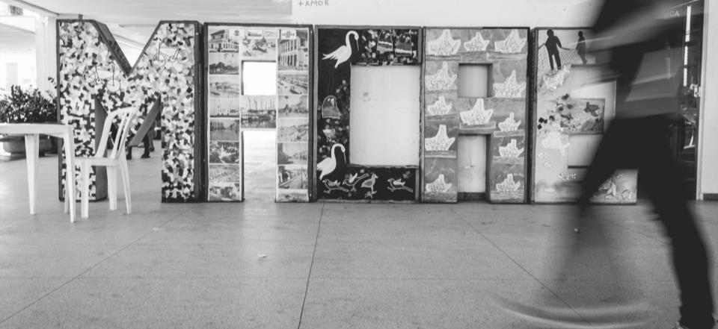
Macaé campus - by Raphael Pizzino

Slide 18


Teacher training complex
It brings together the schools and faculties responsible for teaching degrees, the Faculty of Education (FE) and UFRJ’s Laboratory School (CAp) to work with the other partner institutions and the public education system in order to foster initial and continuing education for teachers.
Photo – Source https://formacaodeprofessores.ufrj.br/

Slide 19
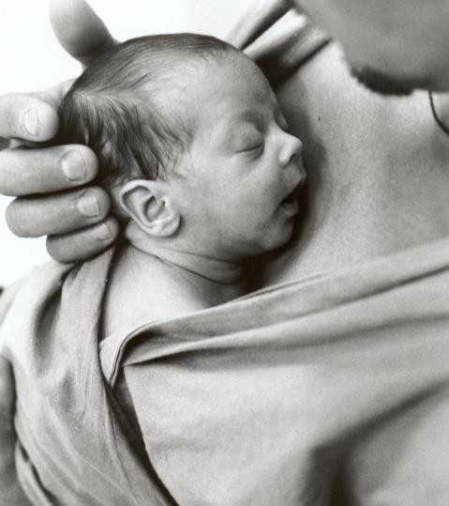
Hospital Complex
UFRJ recognizes its mission to respond to the main health problems in the country, bringing together its staff from the most diverse areas of knowledge in institutes dedicated to providing or proposing healthcare solutions.
The units of the Hospital Complex offer medical care free of charge to the general public through the Unified Health System.
Father holds son in the kangaroo father care method in a unit of the hospital complex – By William Santos.

Slide 20

Complex in numbers
Considering only the hospital network in 2021, there were:
almost 5,000 surgeries;
more than 8,500 hospital admissions;
more than 10,000 emergency care at the hospital;
more than 172,000 consultations.
Med student at the University Hospital – By Raphael Pizzino.

Slide 21









Structure | Hospital Complex
Clementino Fraga Filho university hospital;
São Francisco de Assis Health Care Institute;
Institute of Thorax Diseases;
Institute of Gynecology;
Deolindo Couto Institute of Neurology;
Institute of Psychiatry;
Martagão Gesteira Institute of Child Care and Pediatrics;
Edson Saad Heart Institute;
Maternity School.

Slide 22
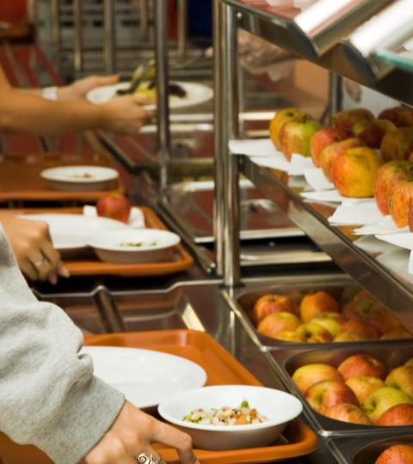
University restaurants
Its objective is to ensure the provision of a balanced diet for the university community, in adequate hygienic and sanitary conditions, respecting the local culture and being socio-environmentally friendly.
BRL 2.00 for students;
3 units at Fundão campus;
1 in Xerém (Duque de Caxias);
1 in the city center;
1 at Praia vermelha campus.
Restaurante Universitário no Fundão – Acervo COORDCOM.
Notes:
Texto do restaurante universitário em formato de imagem.

Slide 23
Teaching and research

Slide 24
“... promoting a fair, democratic and egalitarian society.”

Slide 25
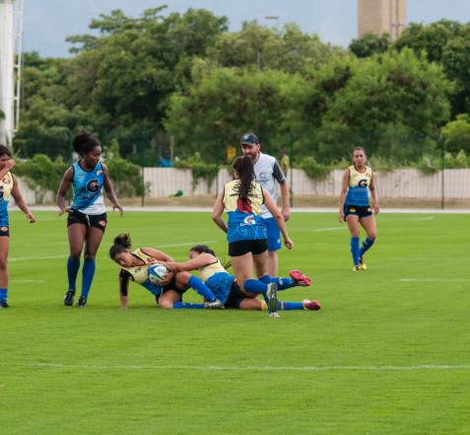
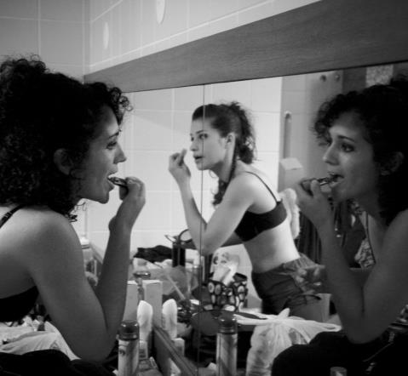
Rugby match at EEFD’s field – By Nathalia Werneck.
On the right: UFRJ’s Dance Group – by Marco Fernandes.

Slide 26
Teaching and Research | Distribution of areas
UFRJ’s schools and faculties are concentrated in the following centers, institutes and complexes:
enter for Legal and Economic Sciences (CCJE);
Center for Mathematical and Natural Sciences (CCMN);
Health Sciences Center (CCS);
Center for Philosophy and Human Sciences (CFCH);
Center for Letters and Arts (CLA);
Technology Center (CT);
Duque de Caxias campus;
Macaé campus;
Teacher Training Complex;
Hospital Complex;
Science and Culture Forum (FCC).

Slide 27
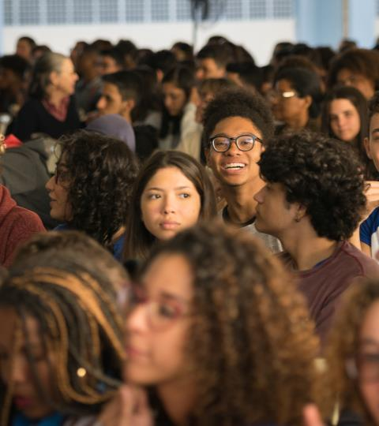
Undergraduate Studies
51.732 students regularly enrolled;
9 thousand places per year;
171 in-person degrees;
4 distance education degrees;
24 evening degrees;
Various benefits granted to low-income students;
Admission through affirmative action based on racial, educational background and social criteria.
Event “Inside UFRJ”. By Raphael Pizzino.

Slide 28
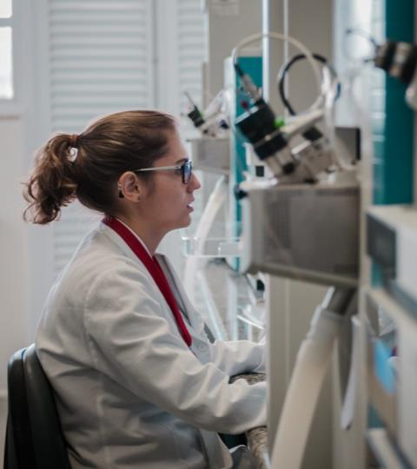
Graduate Studies
currently 16.501 students regularly enrolled;
among the top 3 universities most-cited in articles in Brazil;
200 graduate diploma courses;
134 master’s and PhD programs;
2.000 labs;
hosts 10% of the courses of international standard in Brazil;
admission through affirmative action based on racial and social criteria.
Working at LADETEC (by Raphael Pizzino)

Slide 29

Relationship between the number of graduate programs and CAPES evaluation grade on a scale of 3 to 7, where “A” is a designation for newly approved courses:

Slide 30
Teaching and Research | Excellence
Among the various graduate areas offered by UFRJ, the following got the maximum grade by CAPES:
Systems and Computer Engineering
Physics
Geography
Mathematics
Sciences (Microbiology)
Biological Sciences (Biophysics)
Biological Sciences (Physiology)
Biological Sciences (Genetics)
Morphological Sciences
Biological Chemistry
Science and Technology of Polymers
Mechanical Engineering
Chemical Engineering
Internal Medicine
Communications
Social Anthropology
Sociology and Anthropology

Slide 31
Number of graduate graduated between 2012 and 2018:
Notes:
Não consigo alterar o texto do excel pq não tenho a planilha. Seria “professional master’s”, “PhD” e “master’s”

Slide 32
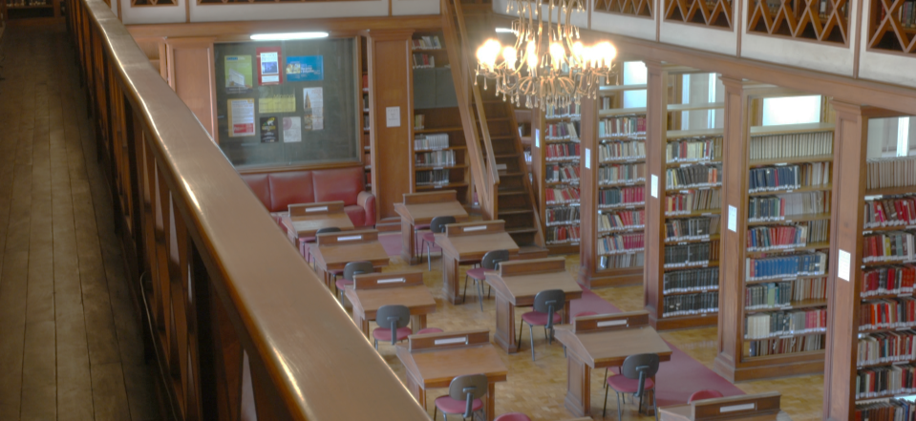
FND’s library – COORDCOM collection

Slide 33
Outreach

Slide 34
“... act as a transforming force.”

Slide 35
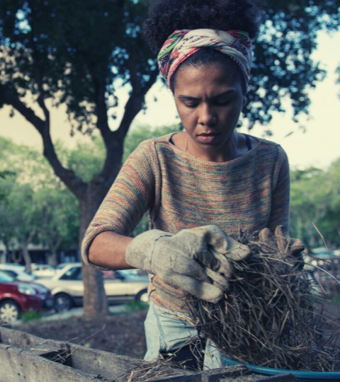
Outreach
2.200 educational projects, artistic activities and courses for the population, in the area of university extension;
SIAC – Academic Integration Week;
Inside UFRJ.
Program linked to the Polytechnic School experiments with ways to reuse food left over from the University Restaurant - by Raphael Pizzino

Slide 36


SIAc – Integration
The Academic Integration Week aims to ensure a space of collective construction, defense of public education, valorization of Science and Technology, Innovation and Culture for the development of the country.
Elementary school student participating in an outreach event – By Diogo Vasconcellos.

Slide 37
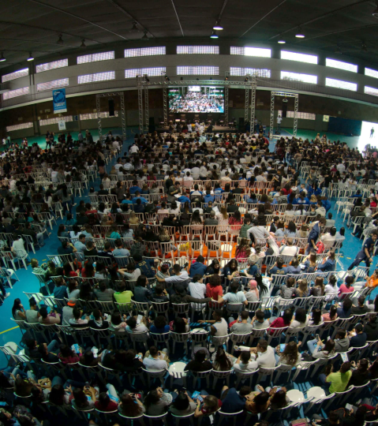

Event “Inside UFRJ”
The event aims to present our institution to those who want to enter Higher Education and also to all those interested in the scientific and cultural production of the Federal University of Rio de Janeiro.
Inside UFRJ – by Raphael Pizzino.

Slide 38
International Relations

Slide 39











International Relations | Associations
UFRJ participates as an effective member in different international associations.
Francophonie University Agency
Association of African Universities
Brazilian Association of International Education
Association of Portuguese Language Universities
Association of Montevideo Group Universities
International Cooperation Group of Brazilian Universities
Todesilhas Group
Interamerican University Organization
Network of International Advisory Services of Higher Education Institutions in Rio
Magalhães Network
Union of Universities of Latin America and the Caribbean

Slide 40
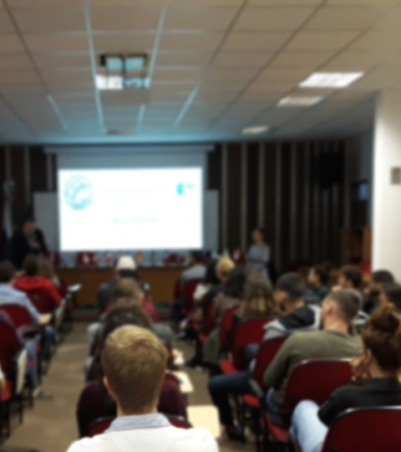
Partners
In addition to international associations, UFRJ also maintains partnerships in programs such as Erasmus+ and Santander Universidades, not to mention more than 200 bilateral agreements with higher education institutions around the world that guarantee research partnerships and academic exchange.
Welcome day – Presenting UFRJ to foreign exchange students.

Slide 41
International Relations| Terms of Agreements
Although the terms of cooperation agreements vary from one university to another, in general they guarantee that UFRJ students:
do not pay tuition fees at the foreign university;
receive a student visa in their passport, which allows them to enroll in the foreign university and stay abroad for the necessary period;
take advantage of the credits obtained at UFRJ at the foreign university.

Slide 42
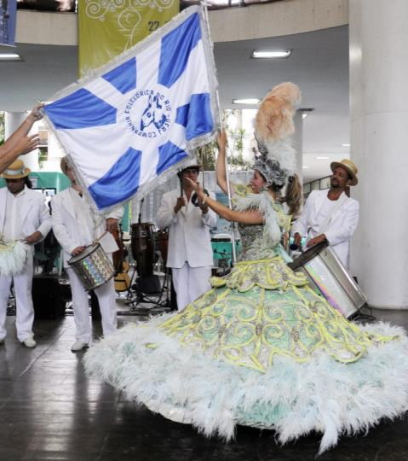
Study abroad in Rio
5º biggest tourist destination in Latin America;
Tropical climate;
Vast cultural richness;
Numerous leisure options;
Circuit of great artistic tours;
Wide availability of commercial services;
Public and free emergency service for foreign tourists.
Carnaval presentation in the hall of FAU’s building – By Nathalia Werneck.

Slide 43
International Relations | Exchange
UFRJ only accepts applications from the international offices of partner institutions.
UFRJ guarantees exchange students :
Free education;
Free Portuguese classes;
University restaurant;
Buddy program.

Slide 44
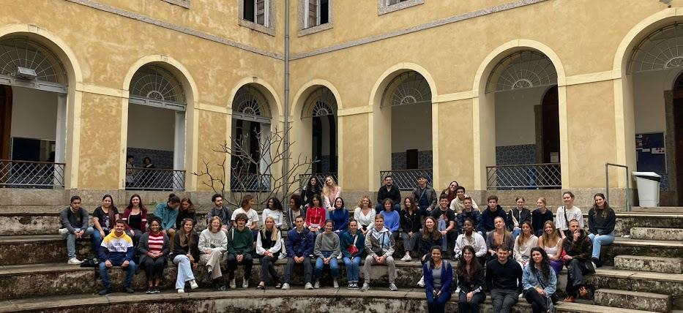
I Foreign Student Integration Week - 2022

Slide 45
internacional.ufrj.br

